Slide 1
Introduction to Programming
Workshop
9 – 10 April 2018
Peter Smyth
University of Manchester,
CMI

Slide 2
Accessing the course materials
The code snippets used, the file needed for the final exercise, the additional exercises and a copy of the notes are all available on Github at;
https://github.com/PeterSmyth12/april2018
Download the zip file and extract it to your laptop, somewhere where you can access it easily

Slide 3
Overview of this workshop
This is what we will cover:
Day 1
What is a computer program?
Defining the problem in words and pictures
Documentation
Python programming constructs
More Python
Introduction to testing and debugging
Processing data from files
Notes:
Leave this for Peter

Slide 4
Overview of this workshop
This is what we will cover:
Day 2
Creating functions and using parameters
Introduction to Object Oriented Programming
Introduction to the Pandas package
Introduction to the Matplotlib package
Creating and running complete programs
Notes:
Leave this for Peter

Slide 5
Computer programming
Art ?
or
Science?

Slide 6
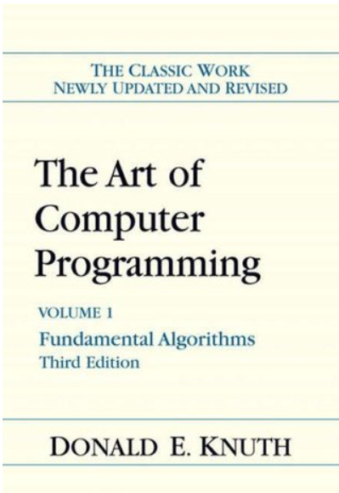
Computer programming

Slide 7
Lesson 1
What is a computer Program?

Slide 8
Lesson 1
Definitions
computer program - a sequence of instructions that a computer can interpret and execute.
(The Free Dictionary)
A computer program is a collection of instructions that performs a specific task when executed by a computer.
(Wikipedia)

Slide 9
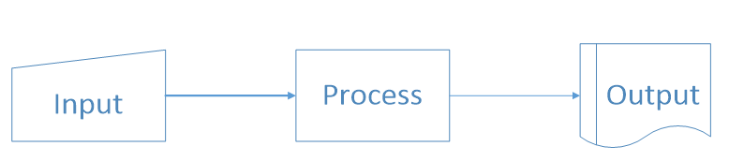
Lesson 1
In pictures
Question – Give examples of input and output

Slide 10

Lesson 1
A simple program
"Hello, World" source code. This first known "Hello, world" snippet from the seminal book The C Programming Language originates from Brian Kernighan and Dennis Ritchie in 1974.

Slide 11
Lesson 1
It is generally easier to read programs than to write them
Regardless of the language
It is usually necessary to add symbols (or tokens) to the written code in order to make it understandable by the computer.
This can help to ensure that the code is not ambiguous

Slide 12
Lesson 1 – stupid computers
Computers can;
Add
Subtract
Compare
And that’s about it!

Slide 13
Lesson 1 – How Programs are run
In very simple terms –
You write your program code to a file as simple text
A compiler program is run which takes your file of code as input and produces a file of machine code as output
The machine code is written to a file. It just looks like a load of numbers to you and me.
Compilers are language specific, in two ways
They only understand code written in their language
They produce machine code that the computer it is running on understands
The Operating System takes the machine code file as input executes the instructions and produces output depending on what your program code said (another program)

Slide 14
Lesson 1 – How Programs are run
Not all language use a compiler –
Python uses an Interpreter.
This combines the compile and execution steps together
The interpreter takes your file of program code and produces output immediately
The use of Interpreters, allows the creation of REPL systems
REPL stands for Read, Execute, Print, Loop

Slide 15
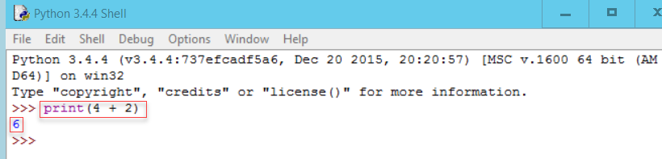
Lesson 1 – How Programs are run
REPL –
Python comes with a REPL environment called IDLE
The first highlighted area is a Python statement
The second is the output produced from executing the statement

Slide 16
Lesson 2
Using words and pictures

Slide 17
Lesson 2
Everyday tasks are often performed automatically. Writing instructions for others to follow can be more difficult.
Exercise – write instructions to do the following;
Make a cup of tea
Boil an egg
You may assume that you are in a well-designed kitchen and everything you are going to need is within arm’s reach.

Slide 18
Comments on the exercise
It is natural to write the instructions as a list of things to do
Although we recognise the tasks as singular, we naturally break them down into sub-tasks
Linear lists do not make it easy to include decisions or choices.
Typically, assumptions will be made. e.g.
gas or electric?
Tea leaves in a pot or bag in a cup?

Slide 19
Lesson 2 - Before you start coding
Even before deciding on a programming language
There are two techniques which can be used to help in the design of your program
Pseudocode and
Flowcharting
You can use both, you should certainly use one.

Slide 20
Lesson 2 - Pseudo code
In general pseudo code consists of simple English phrases on separate lines.
There are however two key rules;
If a line is dependent on the line before, you indent the line.
Use a set of commonly accepted constructs for selections and actions.

Slide 21
Lesson 2 - Pseudo code
A simple example – Exam results
If student's mark is greater than or equal to 60 print "passed" Else print "failed"
EndIf
The second and fourth lines are indented because they depend on the lines above
The If…Else…EndIf construct is used to indicate a selection (do this or do that)

Slide 22
Lesson 2 - Pseudo code
The commonly used constructs
To denote | Use
Loops | Do While...EndDo
 | Do Until...EndDo
Selections | If...Endif
 | If…Else…Endif
 | Case...EndCase
A process or sub-process | Generate
 | Compute
 | Process
An individual action | set, reset, increment, compute, calculate, add, sum, multiply, print, display, input, output, edit, test …

Slide 23
Lesson 2 - Pseudo code
The link below suggests some kind of standards for pseudo-code
http://www.volkergaul.com/MSTC/Courses/Programming%20Logic%20-%20Beginning/Assignments/Unit%203%20-%20Program%20Design/Pseudocode%20Standards.pdf
These guidelines seem to be specifically aimed at C# programmers.
Other searches will find other ‘standards’
Focus on simple words and clarity

Slide 24
Lesson 2 - Pseudo code Example
set total, counter and average to 0
Input the first score
Do while the user has not entered the final score
add this score to the total
add one to the counter
input the next score
EndDo
if the counter is not equal to 0
set the average to the total divided by the counter
print the average
else
print 'no grades were entered'
endif

Slide 25
Lesson 2 - Flowcharts
A flowchart is a diagrammatic way of representing your algorithm or program
It is a graph with directed lines representing the edges
And a series of symbols representing the nodes
The Symbol used in some way represents the purpose of the node

Slide 26
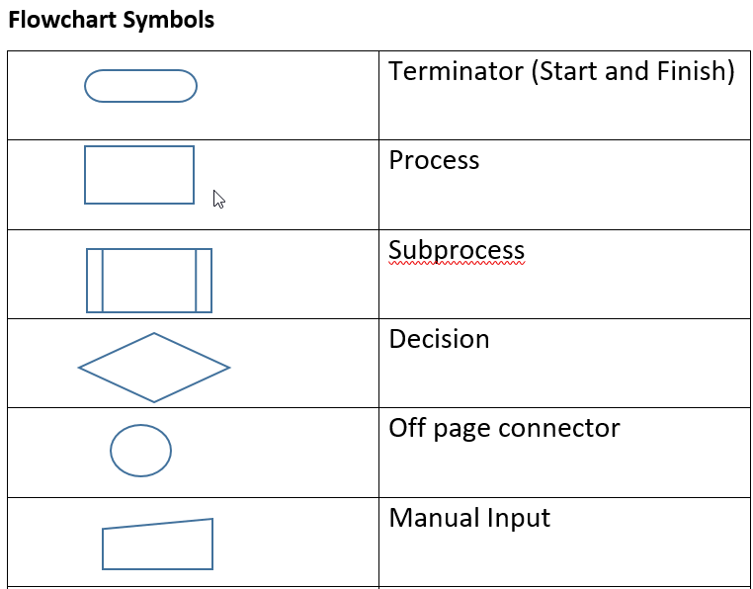
Lesson 2 - Flowcharts
Some of the key symbols are shown here

Slide 27
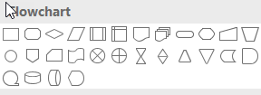
Lesson 2 - Flowcharts
The flowcharting symbols are available from MS Word and other packages
In practice it is normally more convenient to start your flowchart freehand (pen and paper!)

Slide 28
Lesson 2 - Flowcharts
The following slides illustrate how several of the selections and actions referred to in the pseudo code section are realised as flowchart segments.
Remember however that a complete flowchart will consists of many of these segments together so as to represent the complete task.

Slide 29
Lesson 2 – Flowcharts If…Endif
Start
Is colour Blue?
N
Y
Do something for Blue
End

Slide 30
Lesson 2 – Flowcharts If…Else…Endif
Start
Is colour Blue?
N
Y
Do something because it is not Blue
Do something for Blue
End

Slide 31
Lesson 2 – Flowcharts Do While…EndDo
Start
Is condition TRUE
N
Y
Do something
Do something, possibly setting condition to FALSE
End

Slide 32
Lesson 2 – Flowcharts Do Until…EndDo
Start
Do something
Do something, possibly setting condition to FALSE
N
Is condition TRUE
Y
End

Slide 33
Lesson 2 - Flowcharts
The label from the condition don’t have to be Y and N
Start
x <= 0
Value of x?
x > 0
Do something because it is not Blue
Do something for Blue
End

Slide 34
Lesson 2 - Exercise 1
Convert your English task into pseudo-code and a flowchart
Don’t forget:
gas or electric?
cup or pot?
pour tea or milk first?
do you take sugar?
Hardboiled or soft boiled?

Slide 35
Lesson 2 - Exercise 2
The diagram on the next slide is meant to represent a flowchart to decide the largest of 3 (not equal numbers)
Find 2 things wrong with the flowchart and correct them

Slide 36
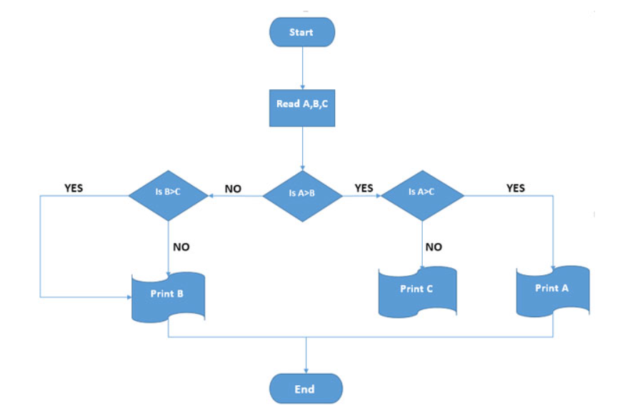
Lesson 2 - Exercise 1
What is wrong with this Diagram?

Slide 37
Lesson 3
Documentation

Slide 38
Lesson 3
All computer programs should be documented
There are two types of documentation
External documentation and
Internal documentation

Slide 39
Lesson 3 - External documentation
Examples
Program Title
Program specification or description
What the program does
How it is to be used
Indication of inputs and outputs
Constraints
Pseudo-code / Flow charts

Slide 40
Lesson 3 – Internal documentation
All programming languages allow the programmer to include comments in the file of program code.
Different languages have different ways of allowing the programmer to write comments. In Python, there are two different ways
Line comments and block comments
You can use whatever is the more appropriate
All programs should have a block comment at the beginning of the file
In line comments should be used as required but sparingly – you don’t need to comment the obvious

Slide 41
Lesson 3 – Internal documentation
Example (Python)
# A comment on a line by itself by starting the line with the '#' sign
print("Hello world") # everything after the '#' is also a comment
"""
You can also have multiline comments
by using the triple quotes at the beginning and end
"""

Slide 42
Lesson 3 – Internal documentation
Block comment at the beginning of the file
"""
Program Name :
Author :
Date written :
Description :
Inputs :
Outputs :
Calls :
Is called by :
"""

Slide 43
Lesson 4
Python programming constructs

Slide 44
Lesson 4 – About Python
Python is a very popular general purpose language which is used extensively for data manipulation and data analysis.
The official Python website is at www.python.org
From here you can download different versions of Python
Complete documentation is also available from the site
If stuck, you can google; ‘how do I … in python’
There will be plenty of responses
Answers from ‘stackoverflow’
Links to official documentation etc.

Slide 45
Lesson 4 – Running Python code
Python code is just text, you can use any text editor
You then need to explicitly run the code
This is rarely done
And almost never during development
When you install Python you will get a small IDE (Interactive Development Environment)
This includes the REPL environment we saw in Lesson 1
This is what we will be using for this workshop today
There are most sophisticated environments such as;
PyCharm
Jupyter or Ipython notebooks

Slide 46
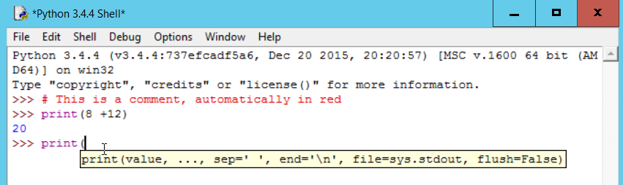
Lesson 4 - IDLE
Notice the colour coding for the different elements
When you type the open bracket for a function, IDLE automatically provides some help
IDLE has many other useful features.

Slide 47
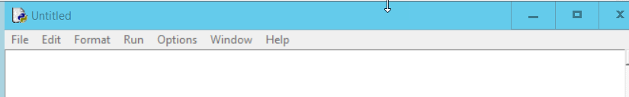
Lesson 4 – more IDLE
You can use IDLE to create a file of code and then run the code as a complete program
This is what you most commonly do when developing
You create a new file (not a new REPL window) by selecting File | New File (or ctrl+N) from the REPL window
This opens a new ‘notepad’ like window with extra options in the menubar - like ‘Run’

Slide 48
Lesson 4 – more IDLE
You can also open an existing file of Python code using File | Open
Many of the examples for the coding constructs we wish to look at have been pre-written for you in the files you downloaded from GitHub.

Slide 49
Lesson 4
Before we start on the constructs, a little bit about operators, variables and types in Python.

Slide 50
Lesson 4
Arithmetic operators
Usual suspects : + - / *
Also
** (raise to the power) and
% (mod)
Comparison operators
<, >, <=, >=, ==, !=
N.B. Equality operator is ‘==‘ NOT ‘=‘

Slide 51
Lesson 4
Logical operators
AND, OR and NOT

Slide 52
Lesson 4
Variables – my definition
A name given by the programmer to an computer decided memory location in which values (appropriate to the variable’s data type) are stored
x = 1
x = 3.4
x = “Some string value”
Python will change the type of x depending on how you use it
Give variables reasonable name (not like above)

Slide 53
Lesson 4 – simpletypes.py
Types
Int => -2, 0, 1, 200001
Float => -1.0, 0.001, 7689.3452
String => “Hello”, “”, ‘either quotes are OK’
Boolean => True or False
print(type(variable_name)) # print the type of the variable
type(variable)) is int # test to see if variable is of type int

Slide 54
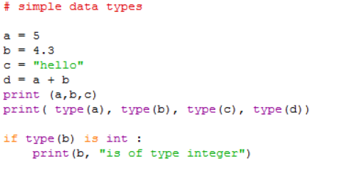
Lesson 4 – simpletypes.py

Slide 55
Lesson 4 – simpletypes.py
We will only be using integers (a), floating point numbers (b) and strings (c).
The type() function will tell you what type a variable is
If you are checking the type in code you use the ‘is’ operator not the ‘==’ operator
variable d is a float because variable b is. If b had been an integer like a then d would also have been an integer

Slide 56
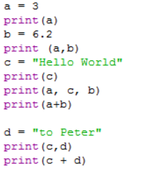
Lesson 4 – print.py

Slide 57
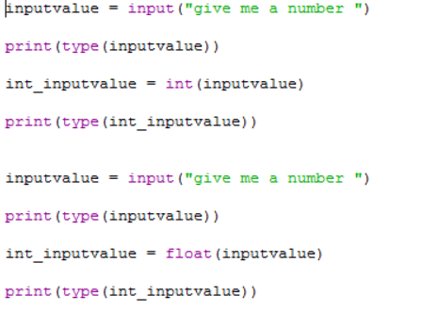
Lesson 4 – input.py

Slide 58
Lesson 4 - Input
Input values are stored as strings. 42 becomes ’42’
If you want a numeric value, the programmer has to convert it using the int() or float() functions
Can be a problem if you are given “Three” and not “3”
Use the ‘try…except’ construct to check

Slide 59
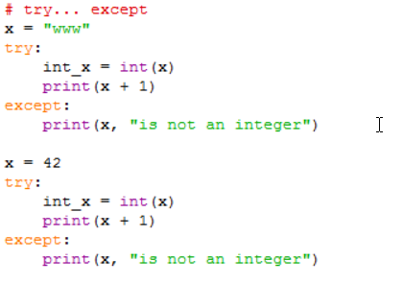
Lesson 4 – tryExcept.py

Slide 60
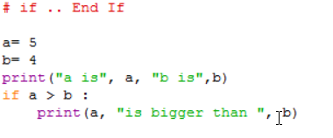
Lesson 4 – if.py

Slide 61
Lesson 4 – if.py
The colon ‘:’ at the end of the ‘if’ line. Missing this out is a common error.
The indentation of the print statement. If you remembered the ‘:’ on the line before, IDLE will automatically do the indentation for you. All of the statements indented at this level are considered to be part of the ‘if’ statement
The equivalent of the ‘EndIf’ is removing the indent.

Slide 62
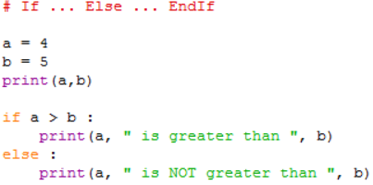
Lesson 4 – ifelse.py

Slide 63
Lesson 4 – ifelse.py
The same structure and formatting rules apply as to the ‘If’ statement.
The block of statements associated with the ‘if’ part is ended by the ‘Else’ clause not being indented.
The ‘Else’ clause also need a ‘:’ at the end of it.

Slide 64
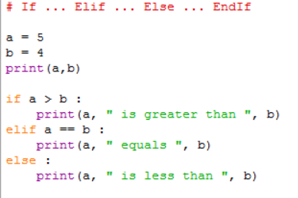
Lesson 4 – ifelif.py

Slide 65
Lesson 4 – ifelif.py
Each ‘Elif’ clause has its own test expression.
You can have as many ‘Elif’ clause as you need
Execution of the whole statement stops after an ‘Elif’ expression is found to be True. Therefore, the ordering of the ‘Elif’ clause can be significant.
Notice that in Python the operator used to check equality is ‘==’

Slide 66
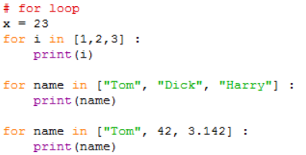
Lesson 4 – for.py

Slide 67
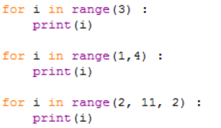
Lesson 4 – for.py

Slide 68
Lesson 4 – for.py
The general format of the ‘for’ loop is:
for <variable> in <sequence>:
<statements>
‘variable’ can be any variable, typically is named and used just for that particular ‘for’ loop or is a general ‘counting’ type variable like ‘i’.

Slide 69
Lesson 4 – for.py
The ‘:’ at the end of the ‘for’ statement. This is required and if you are using IDLE will automatically indent the next line.
‘<sequence>’ is anything that you can count through. In the first example a simple list of integers is used and in the second a list of strings.
The list in the 3rd example has a mixture of data types. This is more a function of lists that the ‘for’ loop

Slide 70
Lesson 4 – for.py
The last 3 examples use the range() built-in function to generate the sequence. You might think that range(3) is equivalent to the list [1, 2, 3] but in fact it is the list [0, 1, 2].
Similarly the range(1, 4) does not equate to the list [1, 2, 3, 4] but to [1, 2, 3]. The first parameter represents the start position in the sequence and the second parameter is one beyond the last value.
In the last example, the 3rd parameter is a step value, so in this case only every second value in the sequence will be used.

Slide 71
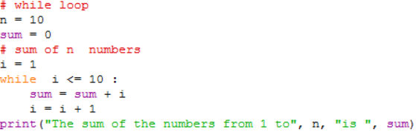
Lesson 4 – while.py

Slide 72
Lesson 4 – while.py
The condition clause (i <= n) in the while statement can be anything which when evaluated would return a Boolean value of either True of False.
The clause can be made more complex by use of parentheses and ‘and’ and ‘or’ operators
The statements after the while clause are only executed if the condition evaluates as True.
Within the statements after the while clause there should be something which potentially will make the condition evaluate as False at some point.

Slide 73
Lesson 4 – dountil.py
There is no direct equivalent of the ‘do … until’ construct in Python. Instead a specially designed while loop is used in conjunction with the Python Break statement

Slide 74
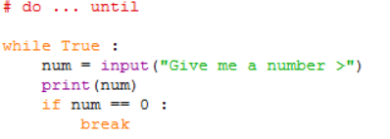
Lesson 4 – dountil.py
There is an error in the code above – What is it?

Slide 75
Lesson 4 – dountil.py
The condition in the while clause is simply the Boolean value True. This means that in theory this program will loop forever (a very common programming error). Instead of using the Boolean value here some people will write an expression like ‘ 1 == 1’.
The if clause is used to check some other condition and if (when) it becomes True, the Break statement is executed.

Slide 76
Lesson 4 – dountil.py
The break statement has the effect of exiting the complete while loop.
You need to make sure within the statements following the while condition clause that there is something which will allow the condition in the if clause to become True.
There is another Python statement ‘continue’ which is similar to Break but only takes you to the end of the current iteration of the loop. This can be useful in the for loop construct.

Slide 77
Lesson 5
More Python

Slide 78
Lesson 5 - Lists
A list is a group or sequence of items of any type.
We used lists when we were looking at the ‘for’ loop construct

Slide 79
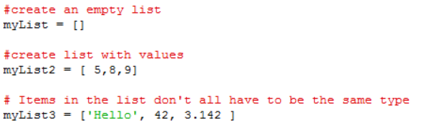
Lesson 5 – lists.py

Slide 80
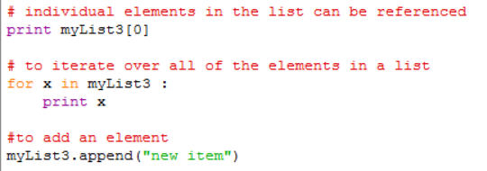
Lesson 5 – lists.py

Slide 81
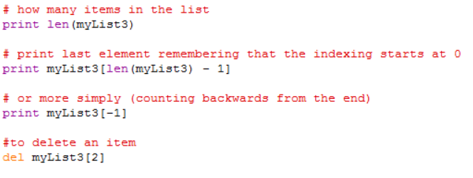
Lesson 5 – lists.py

Slide 82
Lesson 5 – lists.py
Lists are enclosed with [] brackets.
The entries in the list don’t have to be the same type.
Individual items can be accessed by using the index number in [] brackets. Remember that indexing starts at 0 not 1
To access all of the items, you can iterate over them using a ‘for’ loop.
Items can be added using the append() function and removed using the del() function.

Slide 83
Lesson 5 - String functions
The is a whole variety of string functions available in Python. A full list is provided in the official documentation for v3.x here https://docs.python.org/3/library/string.html#string-functions .
We have already seen the len() function when we looked at lists
We will now look at the very important ‘split’ function
Unlike the len() function where the string is passed as a parameter, the split function is built-in to every string
You use it by writing something like;
mysplitupstring = mystring.split(“,”)

Slide 84
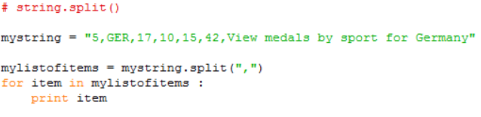
Lesson 5 - split.py
split is a function which returns a list of strings.
The single parameter to split is the character that you want to split the string on. A ‘,’ being quite typical, for a csv file format, but it could be any single character.

Slide 85
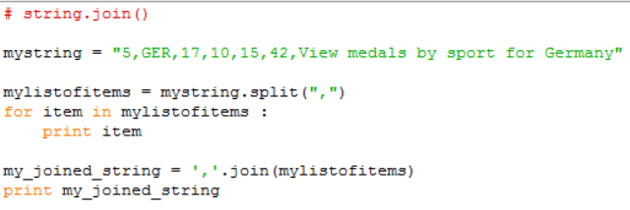
Lesson 5 - join.py
join is a function which creates a single string from a list of strings – the antidote to split
The items in the list all must be strings
In the example, each list item will be separated by a ‘,’. This is quite typical, but any string could be used.

Slide 86
Lesson 6
Testing and Debugging

Slide 87

Lesson 6
http://www.anomalies-unlimited.com/Science/Grace%20Hooper.html

Slide 88
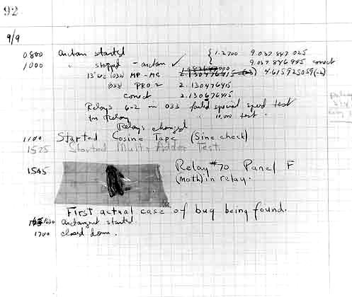
Lesson 6

Slide 89
Lesson 6 - Type of Errors
There are four basic types of errors
Syntax
‘Compile’ time
Run time
Wrong answers

Slide 90
Lesson 6 - Causes of Errors
Error Type | Caused By
Syntax | Written code doesn’t follow the language syntax
‘Compile’ time | Ambiguous or impossible instructions
Run Time | Incorrect Algorithm operation
Wrong answers | Incorrect Algorithm operation or incorrect algorithm used

Slide 91
Lesson 6 Causes of Errors
Common causes of errors
Misspelling of variable names
Python is case sensitive
The name Myvar is not the same as myvar
Incorrect logic
Not anticipating what can go wrong
Trying to do arithmetic on string values

Slide 92
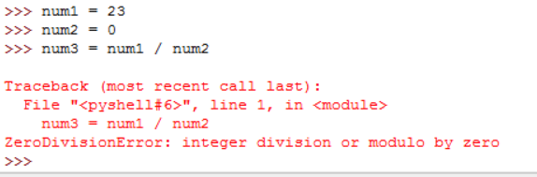
Lesson 6
What does an error look like?
You may get many line of cryptic messages. Generally it is only the last one which is of interest to you – hopefully holding a clue to the problem

Slide 93
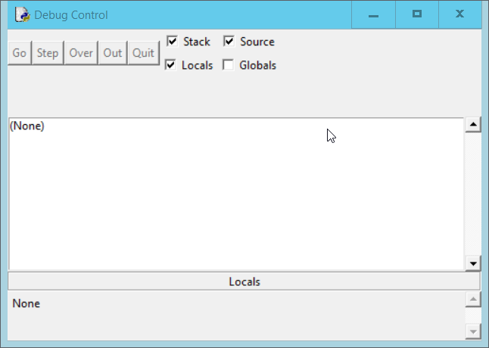
The Idle Debugger – div0.py
To start the debugger
From the Python shell select Debug | Debugger

Slide 94
Lesson 6
What if I don’t have any tools?
If you do not have access to an IDE, you can create a simple debugging environment for yourself by adding additional code to your program. Typically, you might add;
print statements for key variables
dummy input to stop the program

Slide 95
Lesson 6
Introduction to Testing

Slide 96
Lesson 6 - Testing
“If your program works first time, it probably wasn’t worth writing”
(anon)

Slide 97
Lesson 6 - Testing
Testing is a planned process which aims to discover if anything is wrong with the program code.
The most likely problem is that the programming logic or the algorithm is incorrect

Slide 98
Lesson 6 - Testing
Perhaps an indication of how important software testing is considered to be, is the fact that it is covered by a set of ISO (International Standards Organisation) Standards
(ISO 20119-1 to 5).

Slide 99
Lesson 6 – Testing
All programs should be tested. Whether they appear to be working or not
How much depends on size and complexity
How do we know when we have done enough testing?

Slide 100
Lesson 6 - Testing
The answer to the question; When have we done enough testing? is often quoted as;
‘When you have either run out of money or run out of time’

Slide 101
Lesson 6 - Testing
Lessons from History
https://raygun.com/blog/2014/05/10-costly-software-errors-history/

Slide 102
Lesson 6 - Testing
Testing approach
Have a plan! – start it early!
Know what you are testing for
Know what results you expect from any given set of test conditions

Slide 103
Lesson 6 - Testing
Start test plan construction as soon as possible
Some tests can be designed before the code is written
You should aim to test for all reasonable values or ranges of input variables
So you need to know what they are,
Their types
Their valid ranges
And combinations of these

Slide 104
Lesson 6 – Testing - Example tests
For numerical variables test for
Either side of the min and max points
A central point
Real where integer expected
-ve if only +ve expected ( and vice versa)
For string variables test for
Empty string
Overlength strings
Strings on in pre-defined list
Upper and lower case combinations

Slide 105
Lesson 6 – Testing - Example tests
For boolean variables test for
All combinations of True and False
0 and 1 (make sure you know which is which)
0 and -1 (make sure you know which is which)
All combinations of Y, y, N, n, Yes, yes, No, no etc.
Empty string

Slide 106
Lesson 6
In addition to testing variables individually, you need to test them in combination with others
e.g. if 0 <= x < 20, then 0 <= y < 8000
It is the testing of the variables in combination that allows you to test the various branches in the code

Slide 107
Lesson 6 – The Test plan
Test plans and Test results should always be recorded
Use a test sheet to record:
What the test is testing
The values that the variables are to be given
Most importantly – The expected results
The actual results

Slide 108
Lesson 6 – Testing example
As an Example we will re-consider our flawed flowchart from lesson 2
The program it represents is intended to find the largest of three (all non-equal integers) variables A, B and C
As the variables are arbitrarily named and each represents an integer we can use values of 1, 2 and 3 and assign them in all combinations to A, B, and C
This will result in a set of 6 tests shown on the next but one slide

Slide 109
Lesson 6 – Testing example

Slide 110
Lesson 6 – Testing example
Test No. | 1 | 2 | 3 | Expect result | Actual Result | Pass / Fail
1 | A | B | C | C | B | Fail
2 | A | C | B | B | B | Pass
3 | B | A | C | C | C | Pass
4 | B | C | A | A | A | Pass
5 | C | A | B | B | B | Pass
6 | C | B | A | A | A | Pass

Slide 111
Lesson 6 – Testing - VVT
VVT stands for Verification, Validation and Testing.
Testing we have already described as checking if anything wrong with the program code.
Validation considers; Have we written the right program? Does it match the specification we were given?
Verification considers; Have we written the program right? Does the programming logic we have used result in getting the right answers?
Verification and Validation can require tests of their own

Slide 112
Lesson 7
Processing data from files

Slide 113
Lesson 7 – reading and writing files
Files along with databases are the most common sources of input and output for computer programs
Text files which we are interested in can be thought of a single stream of characters.
The stream is conveniently punctuated by special, non-printing characters which represent a new line.
In this way, when you open a text file in notepad, you see a set of separate lines.

Slide 114
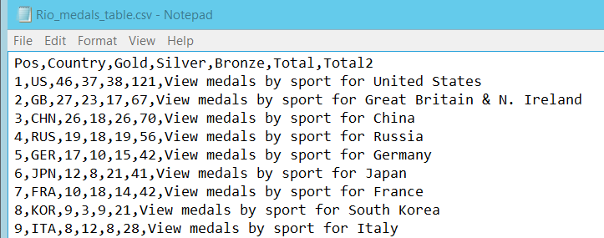
Lesson 7
A simple CSV text file opened in notepad

Slide 115
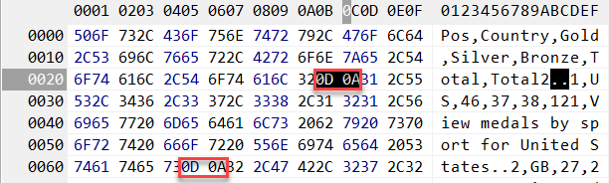
Lesson 7
The same file opened in a more sophisticate text editor showing the internal representation of the characters allows us to see the non-printing newline characters
0A 0D
In English - Line Feed (LF), Carriage Return (CR)

Slide 116
Lesson 7
Because of these LF,CR sequences in the continuous stream of characters, Python can break the file down into a series of ‘lines’
In fact Python considers a text file to be a list of strings.
Each line of the file is a single string.
Because the file is seen as a list it is possible to iterate over the file one line at a time.

Slide 117
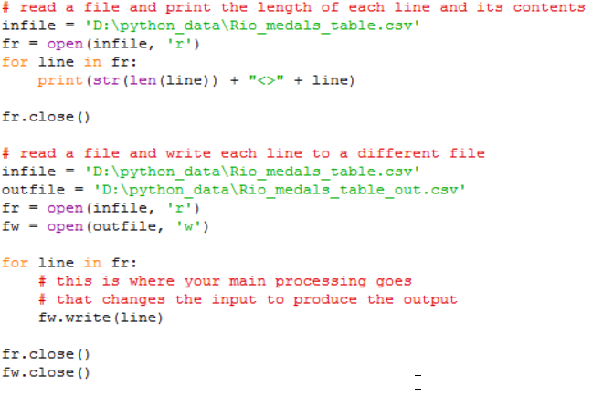
Lesson 7 – files.py

Slide 118
Lesson 7 – Reading and Writing files
The basic function to work with a file is open(). It takes two parameters the first is the name of the file you wish to open and the second an indication of how you intend to use the file. (‘r’ = read, ‘w’ = write, ‘a’ = append)
If you say you are going to write to a file and it doesn’t exist, then it will be created for you.
If you say you are going to write to a file and it does exist, then you will overwrite any existing content

Slide 119
Lesson 7 – Reading and Writing files
Append will also create the file if needed, but if the file does exist then anything written is written at the end of the existing contents in the file
The open() function returns a value of type file. This is often referred to as a file ‘handle’.
A file handle is iterable. You can think of the file as being a list of items where each item is a single record in the file, treated as a single string.

Slide 120
Lesson 7 – Reading and Writing files
Because it is iterable you can use the file as the sequence in a for loop in order to process each line of the file in turn. The loop variable (line in the examples) will automatically contain the next record read from the file.
You write records to a file using the write() function of the file handle associated with the file you are writing to. In the example fw.write(line). line in this case is the whole record read but it could be any string value.

Slide 121
Lesson 7 – Reading and Writing files
If you just wanted to read a single record from a file you could use a statement like; ‘line = fr.readline()’
When you have finished processing a file you should close the file using the close() procedure of the file handle, e.g fr.close()

Slide 122
Lesson 7
Your Turn!

